Slide 1
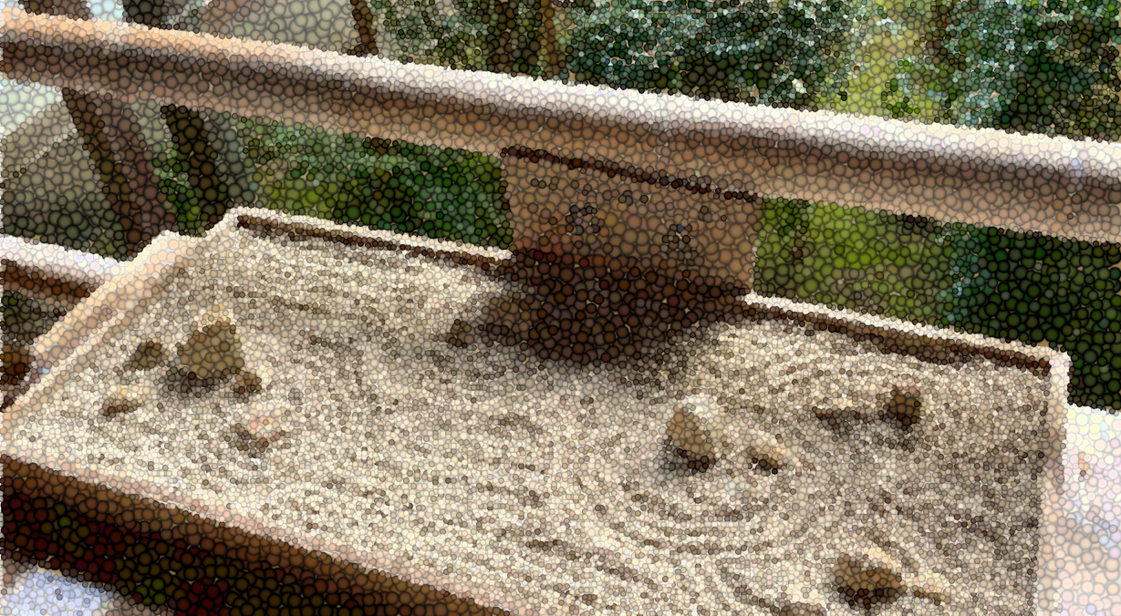
Novel Differential Flow Cytometry Data Analyses Method Using Data Nuggets Compression and Projection Pursuit Algorithms
Davit Sargsyan
Nonclinical Statistics Conference 2024
Wiesbaden, Germany
September 27 (Day 3, 9:10-9:30AM)

Slide 2
Our Team
Prof. Javier Cabrera’s Lab:
Javier Cabrera
Yajie Duan
Mahan Dastgiri
Ge Cheng
Chun-Pang Lin
Prof Ah-Ng Kong’s Lab:
Ah-Ng Kong
Rebecca Mary Peters
PoChung Chou
J&J Colleagues:
Marguerite Emrich
Jocelyn Sendecki
Helena Geys
Kanaka Tatikola

Slide 3

14 Stones of Ryoan-ji
A 15th century Japanese temple of Ryoan-ji featuring a meditation stone garden
Veranda that wraps around the garden opens to a view of 14 large stones

Slide 4

15 (!) Stones of Ryoan-ji
A 15th century Japanese temple of Ryoan-ji featuring a meditation stone garden
Veranda that wraps around the garden opens to a view of 14 large stones
Moving from one sitting spot to another, a careful observer will soon realize that the number of the stones is, in fact 15
But at no point will all 15 stones be revealed to the observer at ones!
Notes:
The true complexity of the structure hidden in a plane site.
Mathematics allows us to understand, manipulate and study objects that exist in higher dimensions. However, our perception is forever bounded by three special dimensions. In order to visualize high-dimensional objects, one must project them onto two-dimensional surfaces. But just like the stones of Ryoan-ji garden, any single projection can always hide the complexity of the object. A reasonable approach, therefore, is to examine it from many different angles.
Techniques such as PCA allow for optimization of 2D projections in such way that we would be observe the object’s most interesting features in terms of their contribution to overall variability.

Slide 5
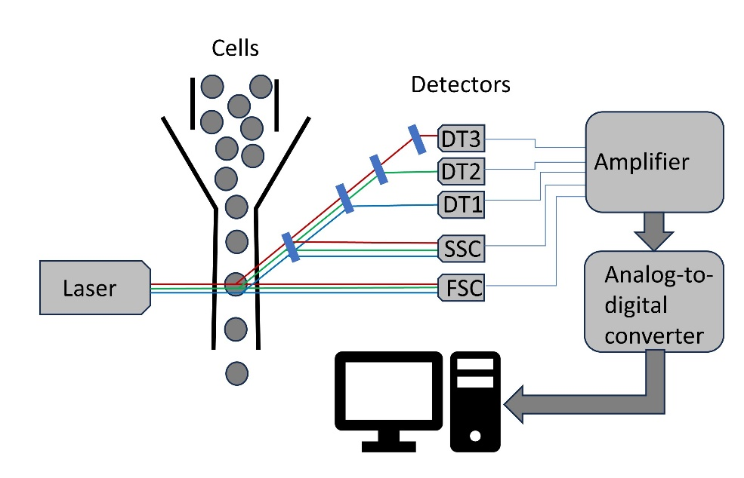
Study Design
Blood samples from 44 infants: 24 Unexposed (UE) and 20 Exposed to HIV (HEU), i.e., mothers diagnosed with HIV
Samples either untreated (Unstimulated) or treated with one of six compounds. We examined Untreated and LPS (lipopolysaccharide) treated samples only.
Each sample analyzed on a flow cytometer. Data published as .FSC files on a public repository.
Combined data had >42M rows (cells or particles). Out of these, ~14M identified as lymphocytes.
Delta[i, j,k] = LPS[i, j,k] – mean(Unstimulated)[*, j,k] for j-th subject and k-th marker (protein)
Remaining ~6.9M lymphocytes (=LPS group)

Slide 6
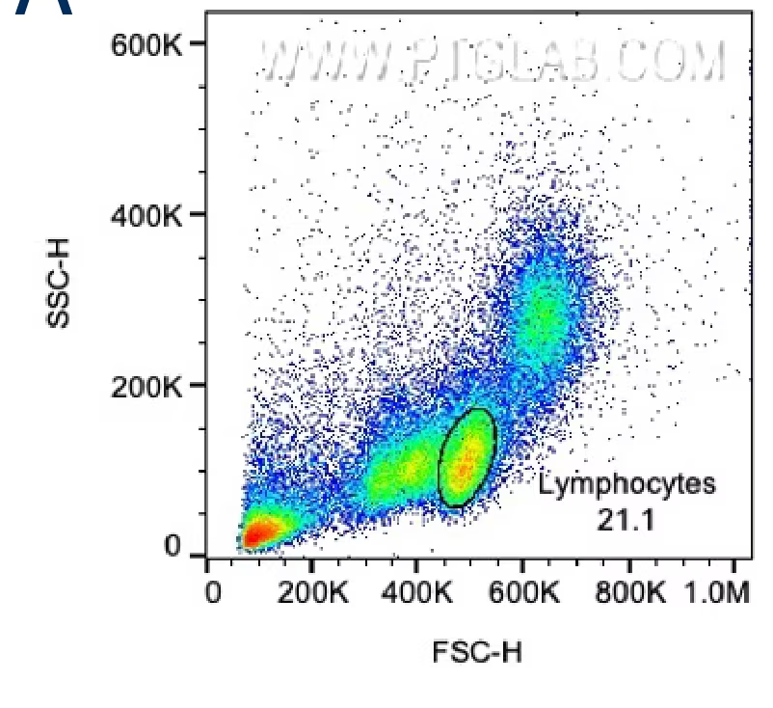
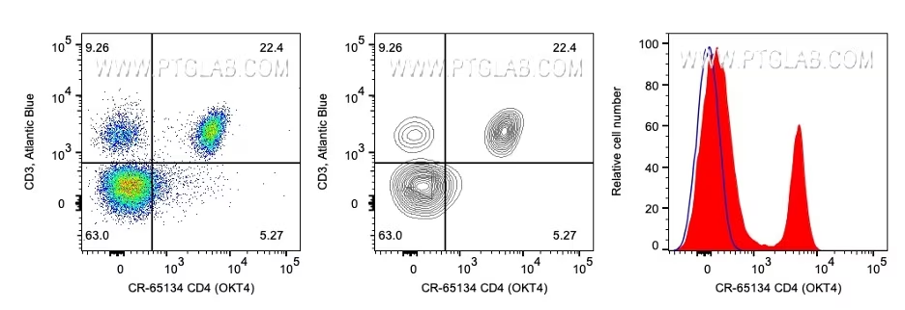
Flow Panel Design
Fluorophore | Marker | Description
FSC-A | Size
SSC-A | Granularity
FITC | IFNa | Pro-inflammatory cytokine (Th cell response)
PerCP-Cy5-5 | MHCII | Expressed by APCs (B cells, Monocytes, Macrophages and Dendritic cells), upregulated upon infection and presentation of antigen
APC-Cy7-A | IL6 | Pro-inflammatory cytokine (Th cell response)
Pac Blue | IL12 | Pro-inflammatory cytokine (Th cell response)
Alexa Fluor 700 | TNFa | Pro-inflammatory cytokine (Th cell response)
PE | CD123 | Dendritic cells
PE-Cy7 | CD14 | Monocytes/Macrophages
APC-A | CD11c | Dendritic cells
How the Immune System Works. L Sompayrac, Wiley 2019
https://www.ptglab.com/news/blog/flow-cytometry-gating-for-beginners/

Slide 7
Flow Panel Design
Fluorophore | Marker | Description
FSC-A | Size
SSC-A | Granularity
FITC | IFNa | Pro-inflammatory cytokine (Th cell response)
PerCP-Cy5-5 | MHCII | Expressed by APCs (B cells, Mono/Macs, DCs), upregulated upon infection and presentation of antigen
APC-Cy7-A | IL6 | Pro-inflammatory cytokine (Th cell response)
Pac Blue | IL12 | Pro-inflammatory cytokine (Th cell response)
Alexa Fluor 700 | TNFa | Pro-inflammatory cytokine (Th cell response)
PE | CD123 | Dendritic cells
PE-Cy7 | CD14 | Monocytes/Macrophages
APC-A | CD11c | Dendritic cells
How the Immune System Works. L Sompayrac, Wiley 2019
https://www.ptglab.com/news/blog/flow-cytometry-gating-for-beginners/

Slide 8
Automated Gating for Data Preprocessing
In each sample, estimate density in FSC vs SSC plot
Identify landmarks (“hill tops”)
Lymphocytes are the bottom right cluster
Identify boundary of the cluster by pixels above a threshold
Delete stand-alone points on the periphery of the cluster (pixel with most neighboring pixels being below the threshold)
Convex hull (“rubber band model”) to smooth the boundaries
Map pixels in density plot back to cells; delete all but lymphocytes

Slide 9
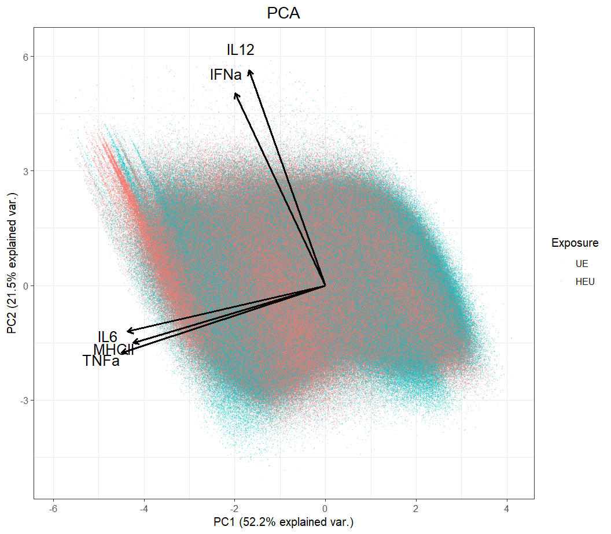
Principal Components Analysis
PC1 explained 52.2% of variability; PC2 21.5%
MHCII, IL6 and TNFa drove the differences in PC1 direction; IL12 and INFa in PC2 direction
Majority of points from UE and HEU overlap. However, we are interested in profiles of cells that are different between UE and HEU
Therefore, a different approach is needed – instead of looking for max variability (PCA), we want to look for max difference (PP)

Slide 10
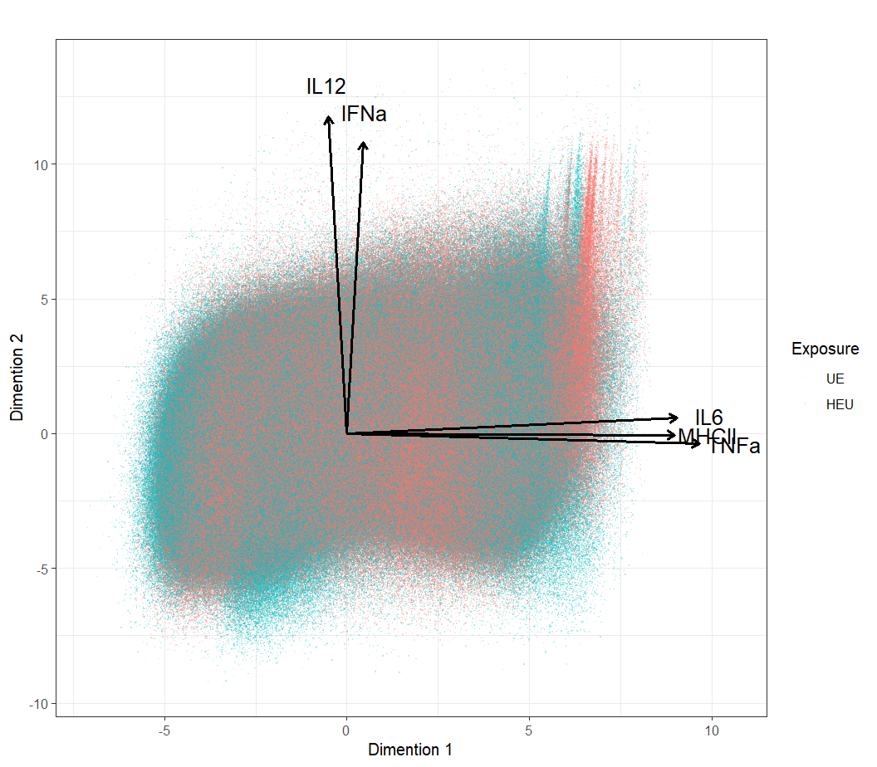
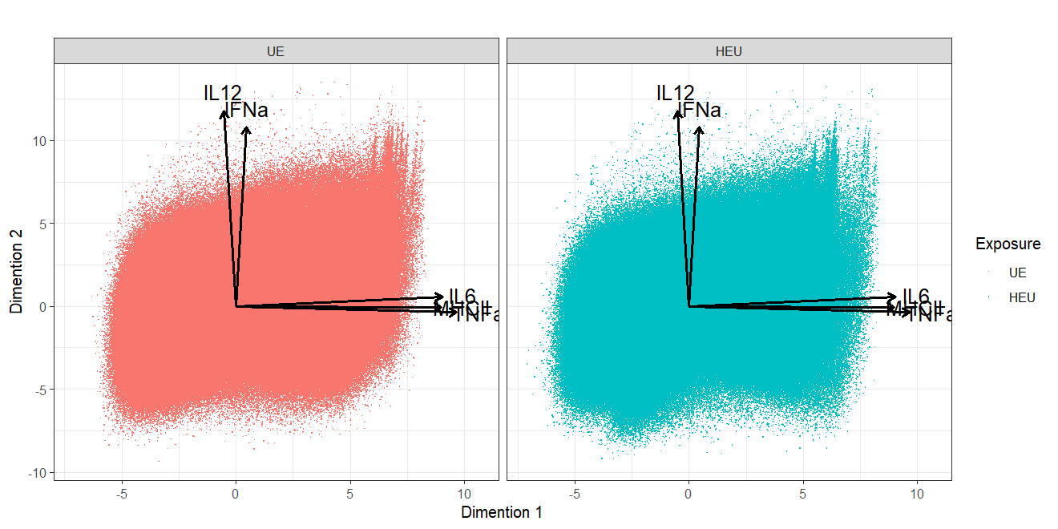
Rotated Principal Components and Differentially Populated Regions

Slide 11
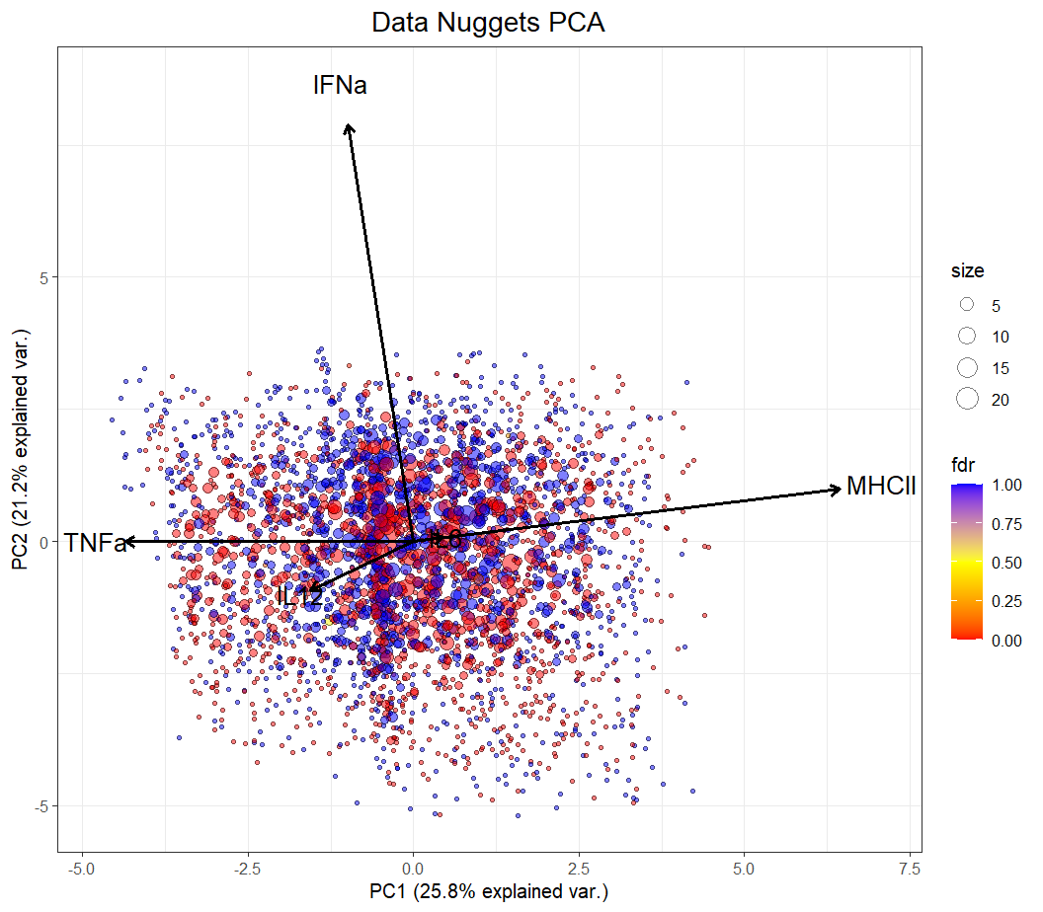
Data Compression with Data Nuggets
Data Nuggets: A Method for Reducing Big
Data While Preserving Data Structure. Beavers et al, arXiv 2024

Slide 12
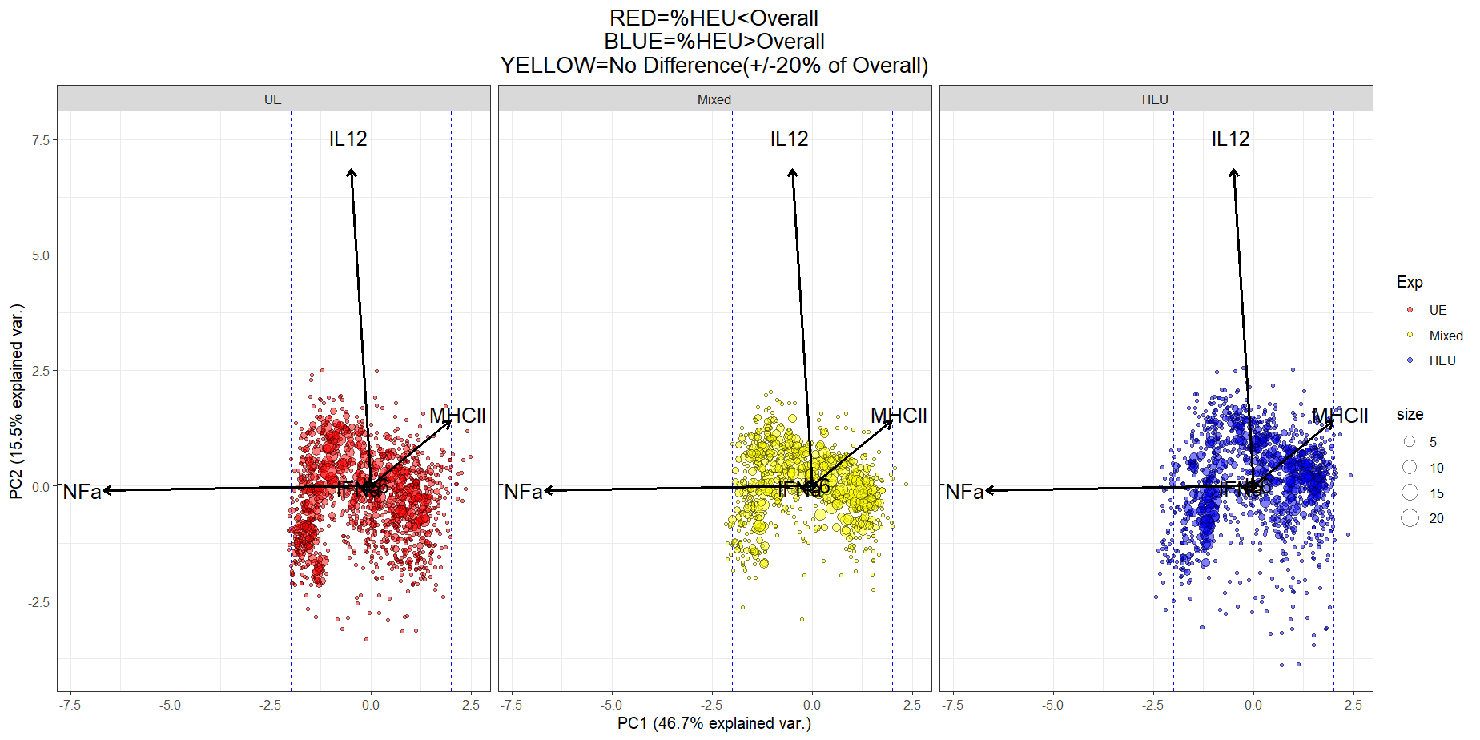
Data Nuggets Biplot by %HEU in Each Nugget vs. in Total (40.5%)

Slide 13
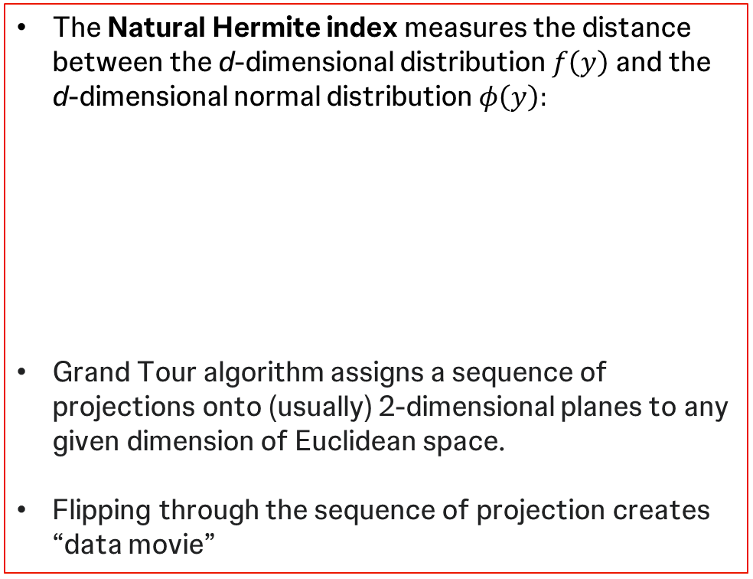
Key Technology
PP searches multivariate p-dimensional data for lower d-dimensional projections, revealing the main structure of the data, i.e., clusters, outliers, and any other low-dimensional nonlinear structure (see Friedman and Tukey 1974).
PP indices (e.g., Natural Hermite index) are functions to numerically measure features of low-dimensional projections
Higher values of PP index = more interesting structures
For PP index optimization, used Grand Tour Simulated Annealing (GTSA) algorithm
The Natural Hermite index measures the distance between the d-dimensional distribution $f\left(y\right)$and the d-dimensional normal distribution $φ\left(y\right):$
Grand Tour algorithm assigns a sequence of projections onto (usually) 2-dimensional planes to any given dimension of Euclidean space.
Flipping through the sequence of projection creates “data movie”

Slide 14
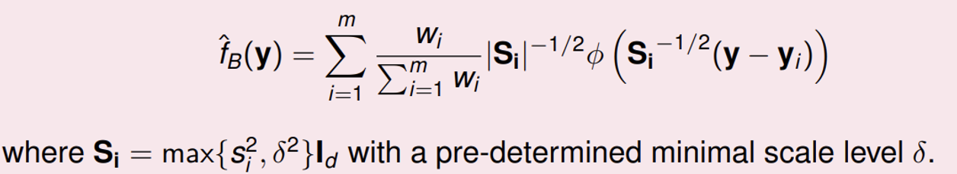
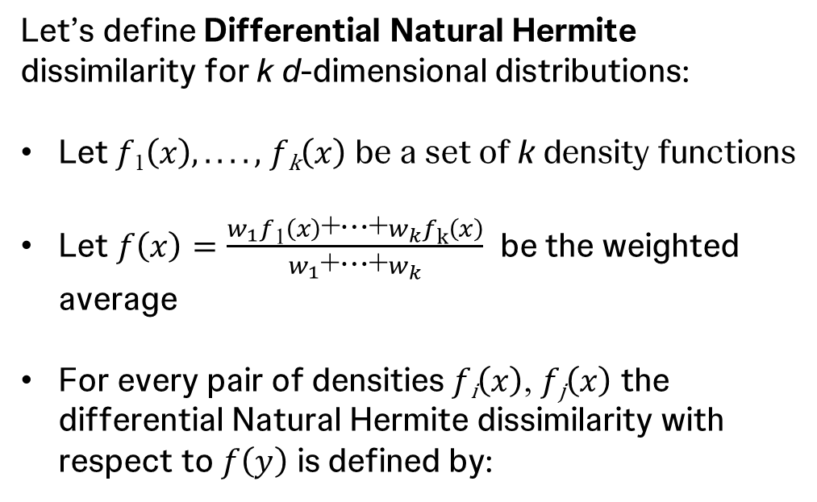
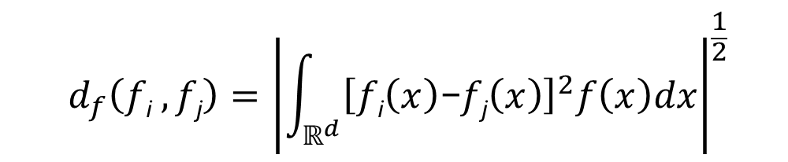
Differential Projection Pursuit
Apply projection matrix OR stop if improvement is small
Calculate density estimators $\hat{f}\text{1}\left(y\right)$ and $\hat{f}\text{2}\left(y\right)$ with Kernel density estimator
Calculate density estimators 𝑓 ̂_{"1"} (𝑦) and 𝑓 ̂_{"2"} (𝑦) with Kernel density estimator
Calculate the index $d_{H,\hat{f}}\left(\hat{f}\text{1},\hat{f}\text{2}\right)$for projection P
Calculate the index 𝑑_(𝐻,𝑓 ̂ ) (𝑓 ̂_{"1"} ,𝑓 ̂_{"2" )} for projection P
Let’s define Differential Natural Hermite dissimilarity for k d-dimensional distributions:
Let $f\text{1}\left(x\right),....,$ $f\text{k}\left(x\right)$ be a set of k density functions
Let $f\left(x\right)=\frac{w_{1}f\text{1}\left(x\right)\text{+}\text{⋯}\text{+}w_{k}f\text{k}\left(x\right)}{w_{1}\text{+}\text{⋯}\text{+}w_{k}}$ be the weighted average
For every pair of densities $f\text{i}\left(x\right)$, $f\text{j}\left(x\right)$ the differential Natural Hermite dissimilarity with respect to $f\left(y\right)$ is defined by:
$${ d}_{f}\left(f\text{i} ,f\text{j}\right)={\left|\int_{ℝ^{d}}{{\left[f\text{i}\left(x\right)\text{−}f\text{j}\left(x\right)\right]}^{2}f\left(x\right)dx}\right|}^{\frac{1}{2}}$$
Density estimator for big data sets based on data nuggets. Duan et al 2024 :

Slide 15
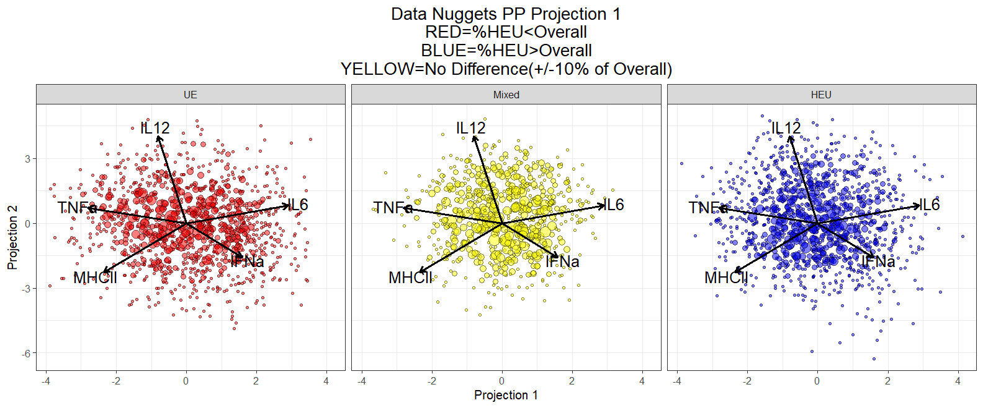
dPP Projection 1

Slide 16
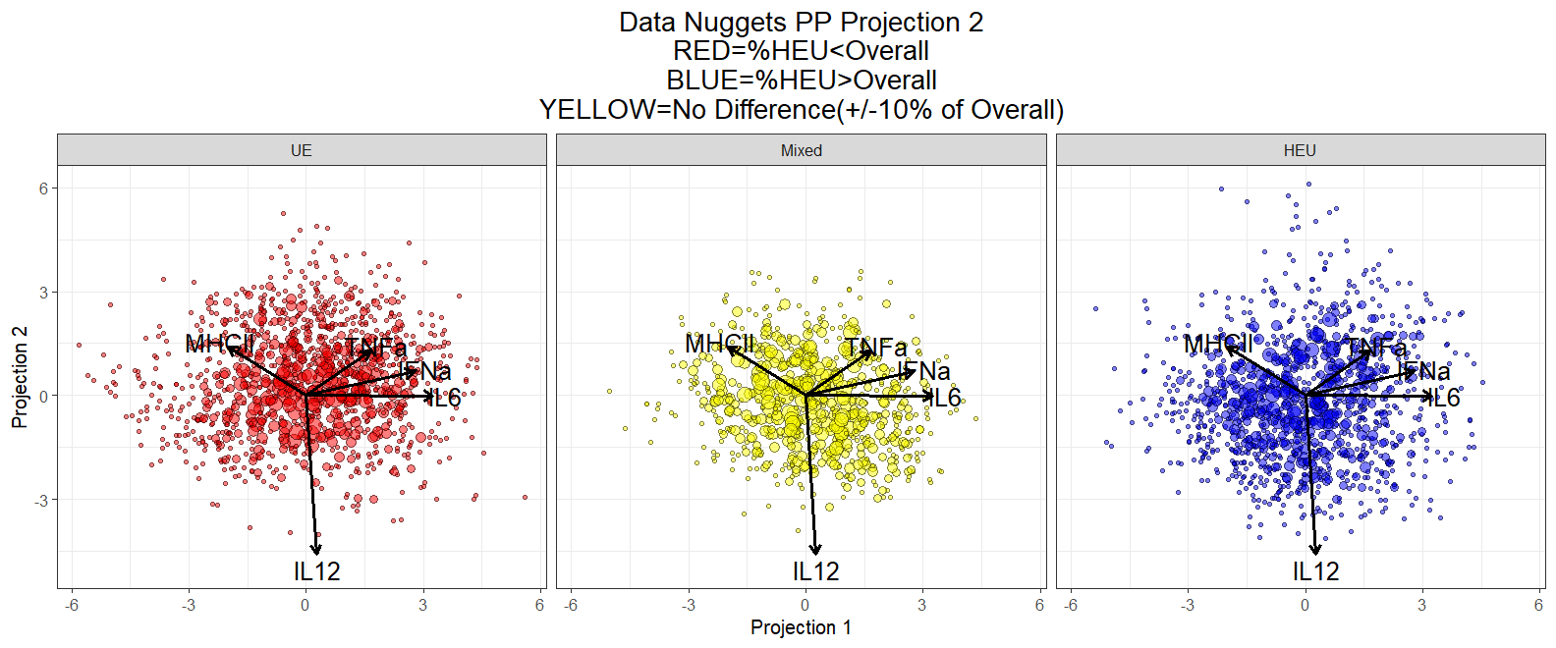
dPP Projection 2

Slide 17
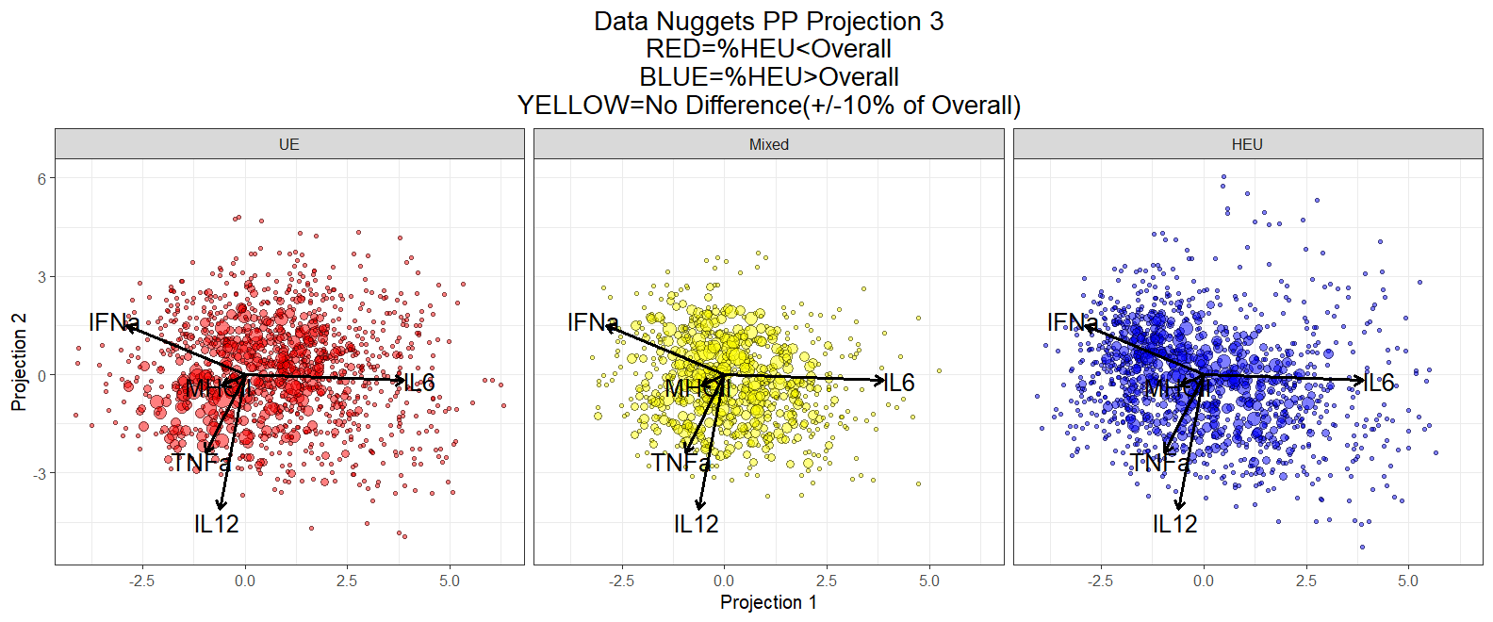
dPP Projection 3

Slide 18
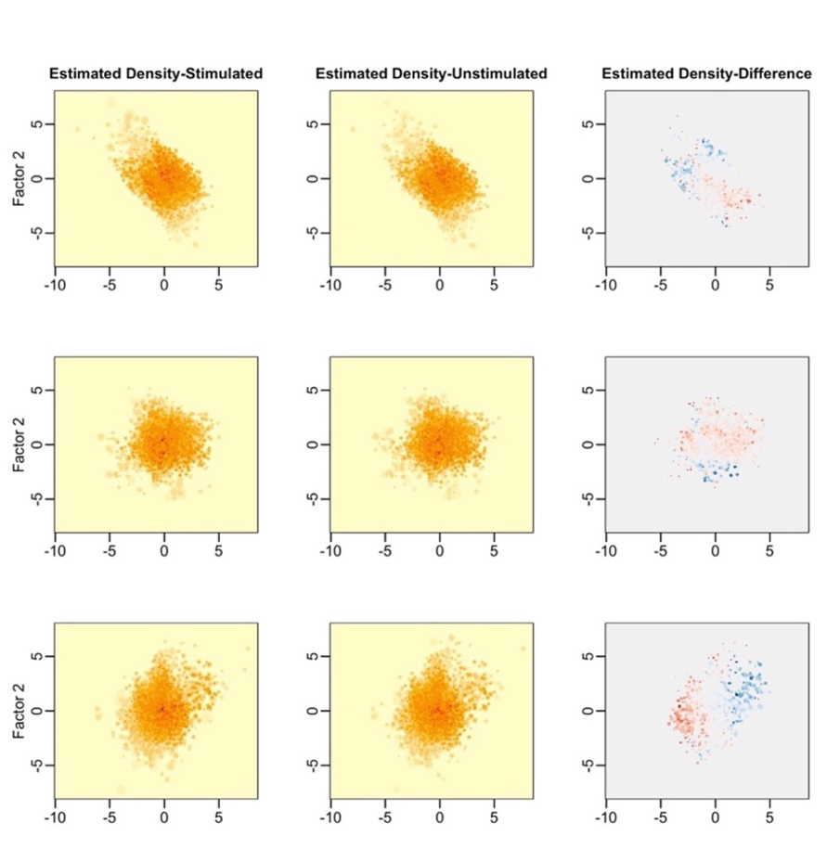
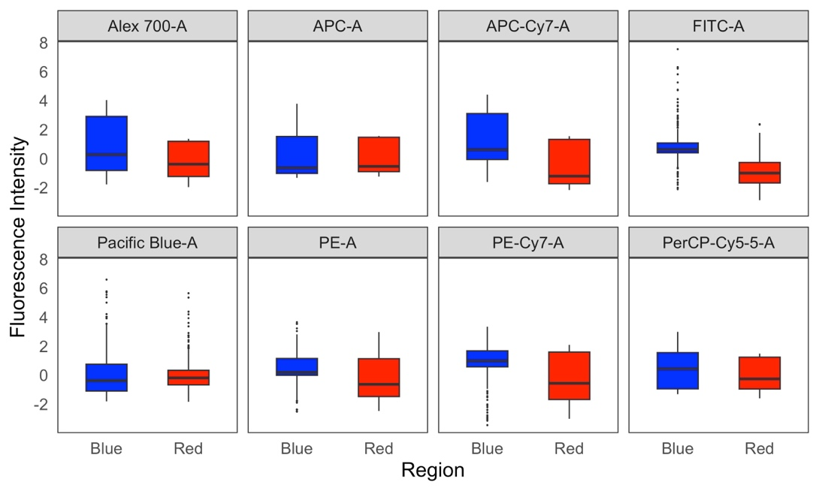
LPS vs Untreated Projections
3 projections of LPS vs. Untreated, optimized for dPP
In the 3rd columnBLUE = LPS>Untreated; RED = LPS<Untreated difference between the two densities

Slide 19
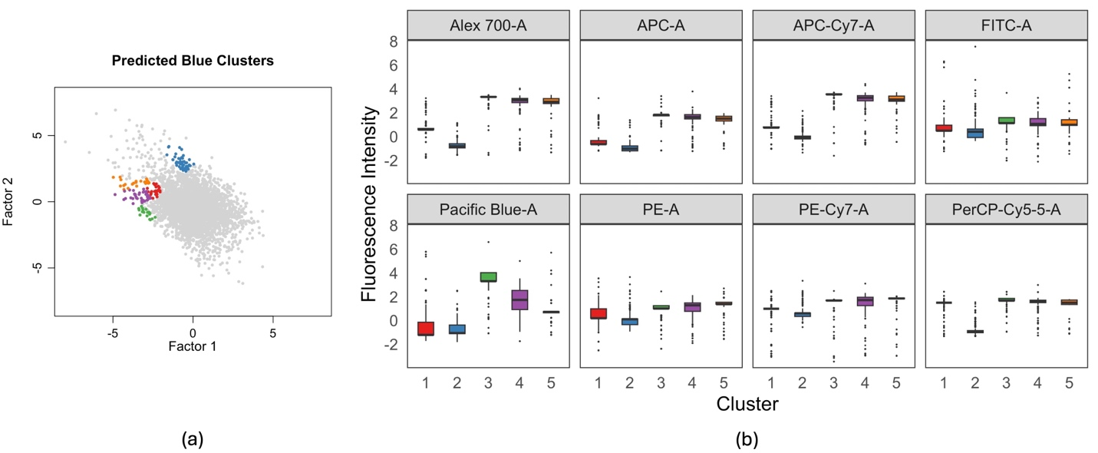
Profiling Cells in Differentially Populated Regions
Novel machine learning approach to differential flow cytometry analysis base on projection pursuit. Dastgiri et al, 2024 (submitted)

Slide 20
Conclusion
Manual or automated gating of flow cytometry data might not be able to capture the structure of multidimensional data
Differential Projection Pursuit creates 2D views complex multidimensional structures, optimized for maximal separation between the experimental groups
The scientists and the statisticians must work as a team to correctly design, analyze and interpret the results of the experiments

Slide 21
References and Publications
A New Projection Pursuit Index for Big Data. Yajie Duan, Javier Cabrera, arXiv 2021 (under revision for JCGS)
Novel Machine Learning Approach to Differential Flow Cytometry Analysis base on differential Projection Pursuit. Mahan Dastgiri, Yajie Duan, Davit Sargsyan, Abraham Adkwei, Rebecca Mary Peters, PoChung Chou, Ge Cheng, Chun-Pang Lin, Jocelyn Sendecki, Helena Geys, Kanaka Tatikola, Ah-Ng Kong and Javier Cabrera (under revision for JBS)
Data Nuggets: A Method for Reducing Big Data While Preserving Data Structure. Traymon E. Beavers, Ge Cheng, Yajie Duan, Javier Cabrera, Mariusz Lubomirski, Dhammika Amaratunga and Jeffrey E. Teigler. arXiv 2024

Slide 22
Thank you!

